Slide 1
Delta Delays
MSA 8030 Communicating with Data – Team 5
Tyler Trocchi, Jared Jones, & Jasmine Weekes
December 10, 2024

Slide 2



Meet the Team
Headshot
Tyler Trocchi
Jared Jones
Jasmine Weekes

Slide 3

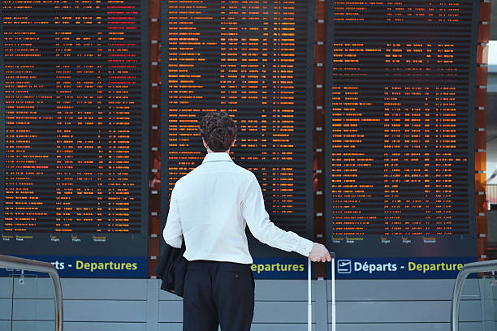
Business Problem
Problem: Our client, Delta Airlines, is looking to improve their operational efficiency by predicting flight departure times and analyzing delay/cancellation causes.
Why it matters: Flight delays and cancellations cost the airline and customer alike.
FAA/Nextor estimated the annual costs of delays in 2018 to be $33 billion.

Slide 4


Explored Use Cases
Use Case | Feasibility | Timeline | Resources | Constraints
Optimize Operations
Departure Forecasting
Cancellation Analysis
Customer Notification & Rebooking
Meets 4/4 criteria!
Notes:
Visual and verbal presentation align perfectly to elegantly and convincingly walk the audience through the use case selection process, how the use cases were prioritized based on criteria like feasibility, resource requirements, timelines, risks, and/or other constraints and argue effectively why the final use case was selected. The reasoning is persuasive and well designed to also convince non-technical business stakeholders.

Slide 5



Chosen Use Case
Departure Forecasting
A neural network model to anticipate flight delays, enabling Delta to adjust resources and communicate accurate ETAs to customers.
This model will be integrated as a package into Delta's employee system and airline app.
Allows Delta to:
Proactively manage operations issues
Adjust staffing and resources
Communicate updates with customers
Meets Business Goals
High Impact
High Feasibility
Notes:
High impact, feasible implementation, aligns with business objective

Slide 6
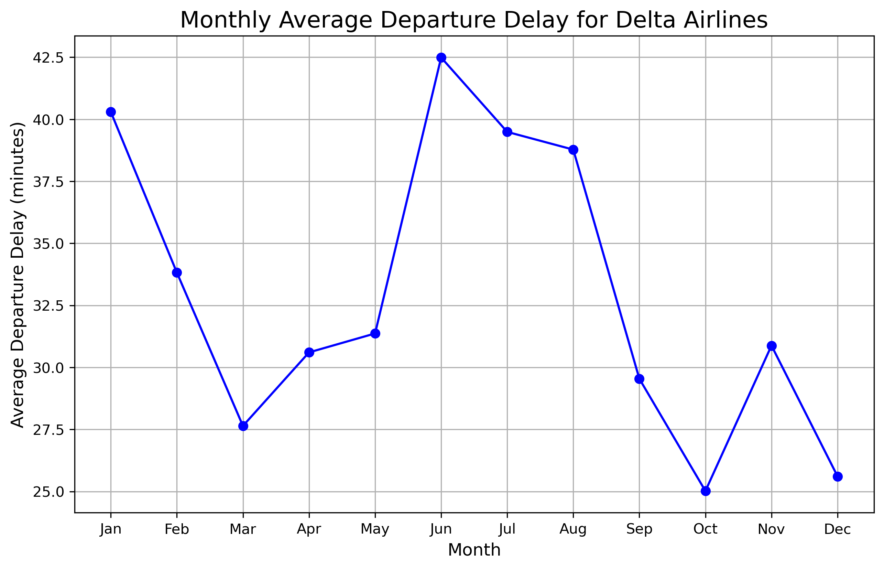
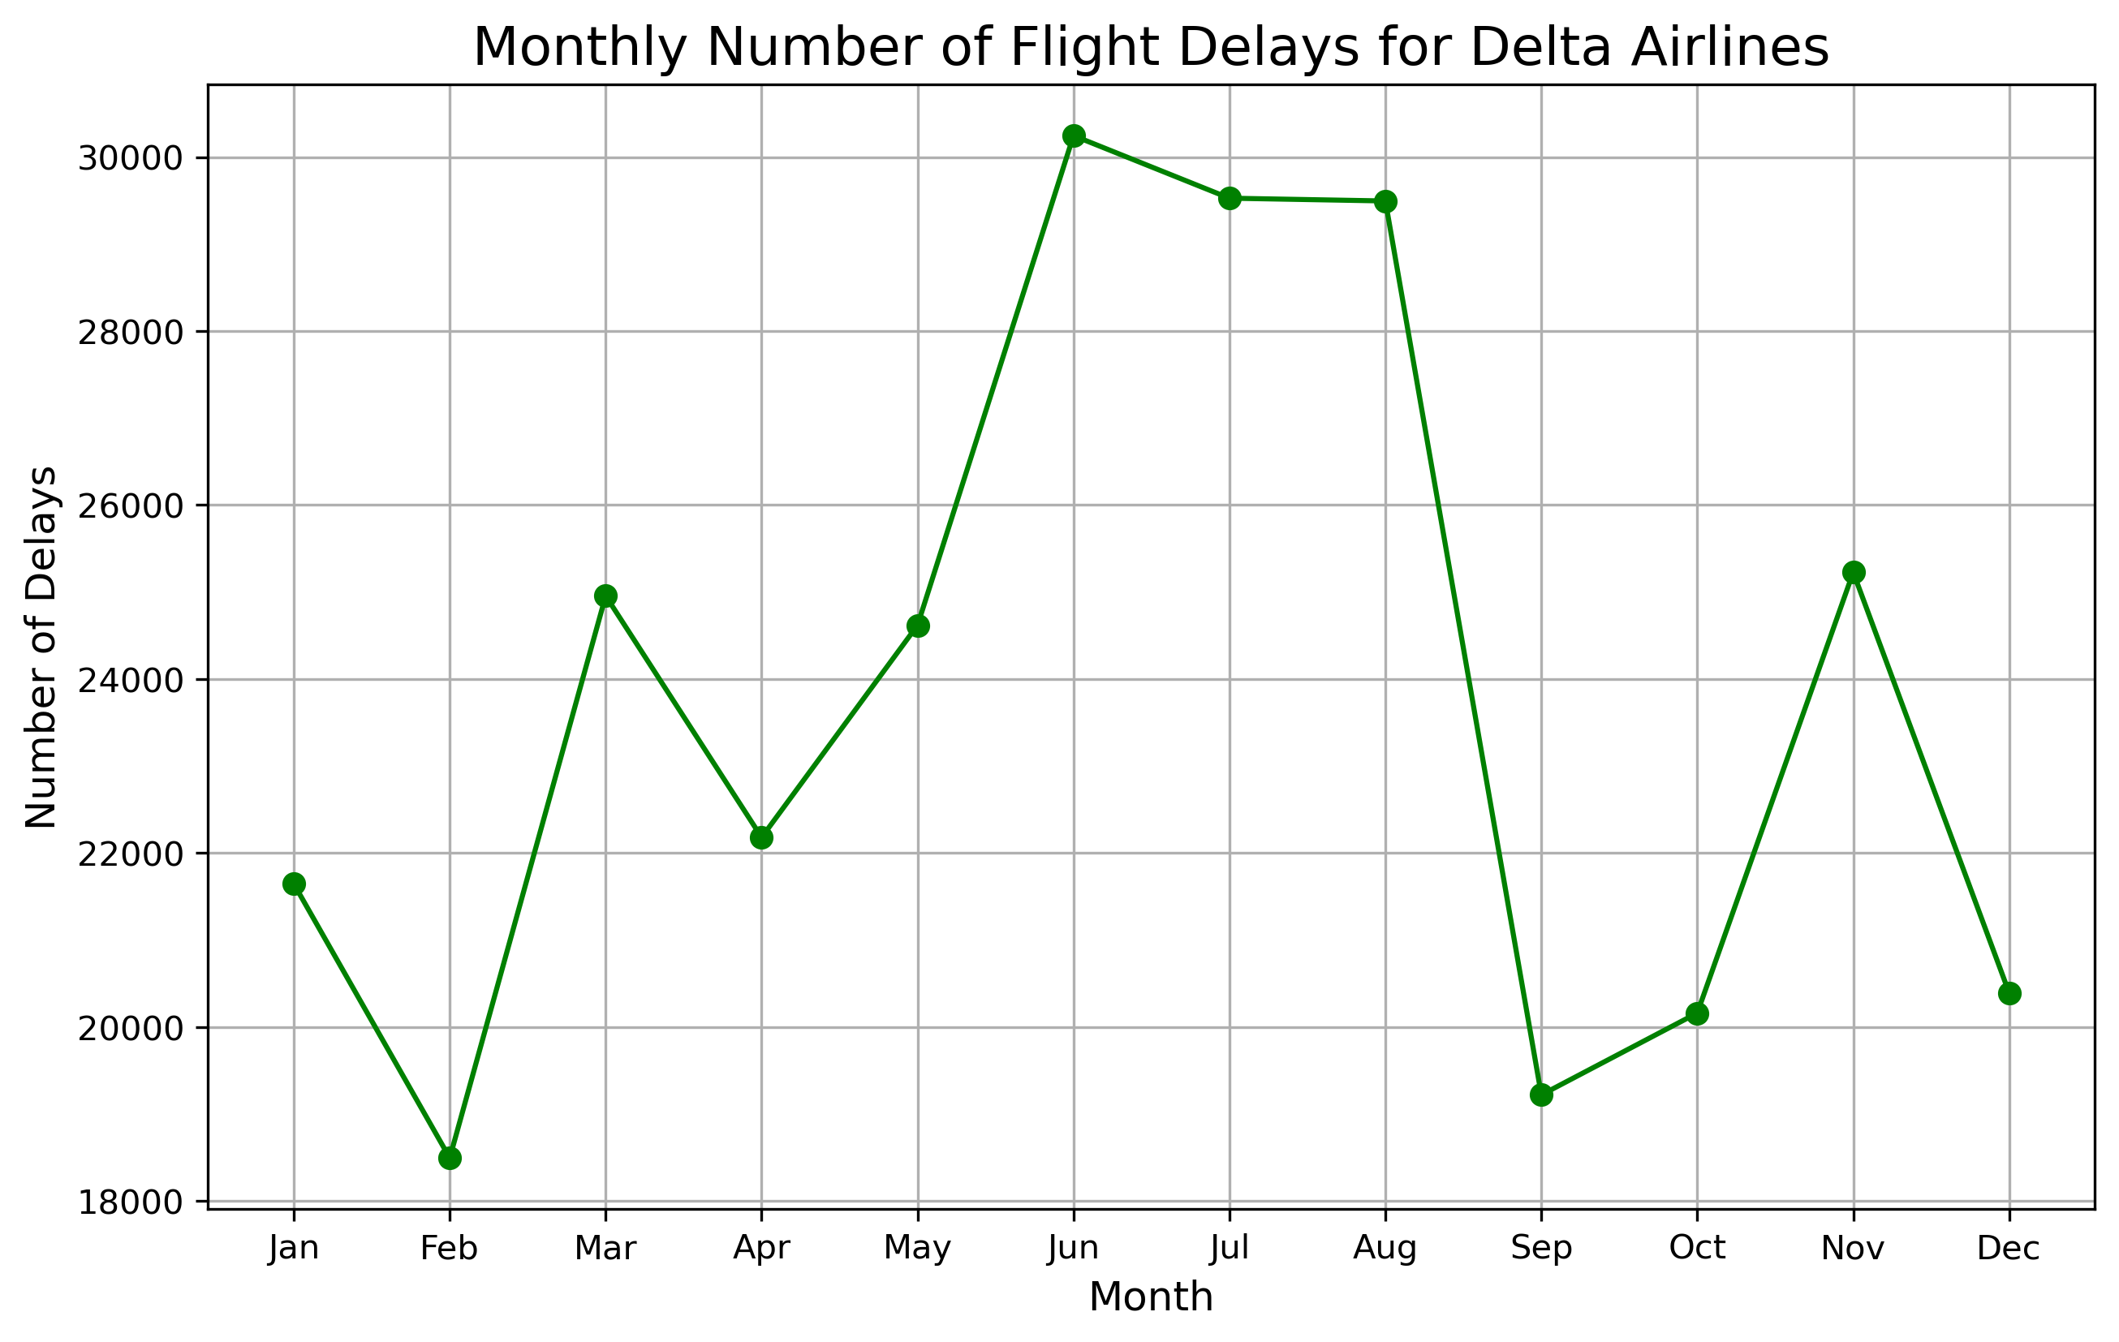
Seasonality
Using yearly patterns throughout the year to anticipate delays/cancellations better.
Delays peak in the summer and beginning of the year.
Even the lowest average delay is over 25 minutes.
Number of delays match up with average delay time very well, except for January and February.
Lowest number of delays is over 18,000 delays.

Slide 7
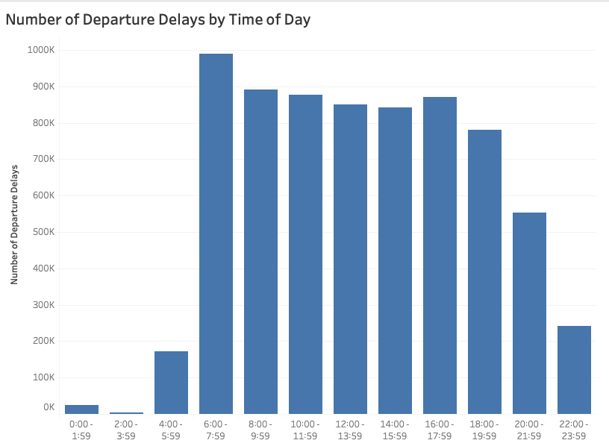
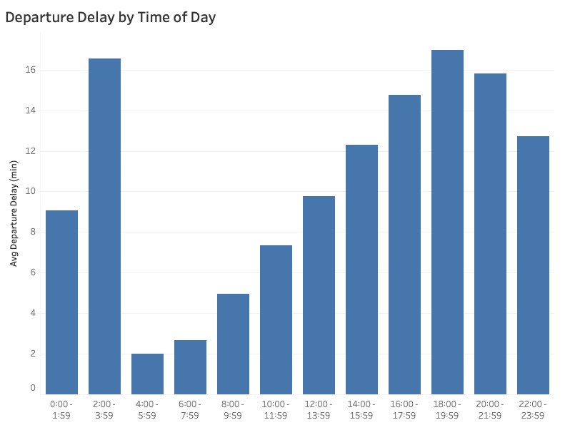
Flight Timing
Spike in delay duration 12am-4am
Frequency lowest during 12am-6am

Slide 8







Business Goal
Increasing Delta's operational efficiency, specifically with flight delays and cancellations
Why It Matters
Flight delays and cancellations cause bad customer reviews and cost airlines billions every year
Method
Neural network predictive model to anticipate delays and provide more accurate flight times
Timeline
Up to 6 months to be created and fully integrated
Results
Reduced added operational costs, better consumer experience, and maintaining Delta's #1 airline rating

Slide 9
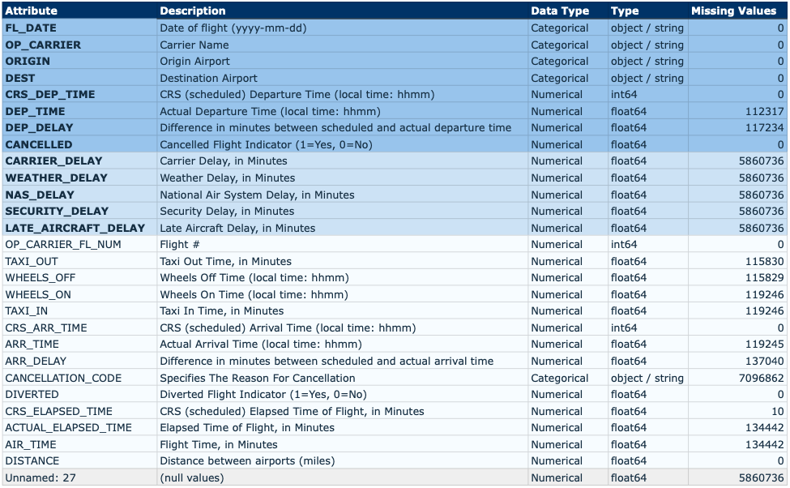
Appendix

Slide 10
Thank You

